Slide 1

Technical
Presented by: John Bellamy

Slide 2
Resources
Snowflake inference service container. See notes in github repo: johnb340/xgboost-wine-snowflake:v1
Github: https://github.com/johnlbellamy/snowpark_ml/tree/master

Slide 3

Agenda
Part I Data Engineering:
Diagram
Tables
Solution Overview
Part II ML On Snowflake:
Song writing Chatbot Brief
E2E Supervised Learning Overview
Data Engineering
Exploratory Analysis & Feature Selection
Transformation/Model Pipeline & Model Repo
Inference Endpoint
Conclusion
QA
Backups

Slide 4
Part I

Slide 5
Solution Overview
This team was tasked with developing a warehouse to support the analysis of data from musical artists. The analysis supports questions involving aggregated data from two fact tables for song plays and play list adds. The proposed technologies for this are Snowflake or Databricks, Python, Azure Event Hub or similar, Python for Databricks/Snowflake SDKs and some visualization tools like PowerBI, SnowSight or Tableau. Data governance and documentation requirements will be discussed in some detail.

Slide 6
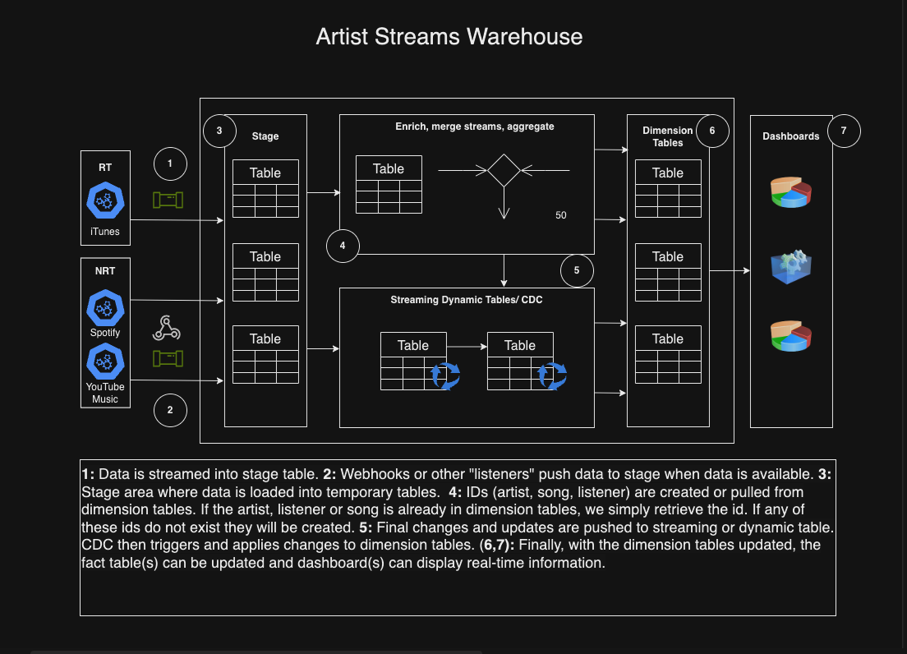
Architecture

Slide 7
Architecture
Based on this use case we can use webhooks and event services like Kafka, Azure Event Hub or even tools native to Snowflake or Databricks. For iTunes, we can use Live tables in Databricks or SnowPipe Streaming. For the other two APIs we can use webhooks if available. If not, we would have to create our own webhooks (WebApps job schedule, ADF Lookups, etc.) to check for new data at an interval not to exceed 2 minutes.
Once an event occurs, stage tables load data from that provider. ETL then associate IDs (initial load) or get ids (incremental load) from the dimension tables. If an ID (artist or listen for example) does not exist in that dimension table, it will be created during CDC. This data is then pushed to streaming/live tables and CDC matriculates changes into dimension and fact tables.

Slide 8
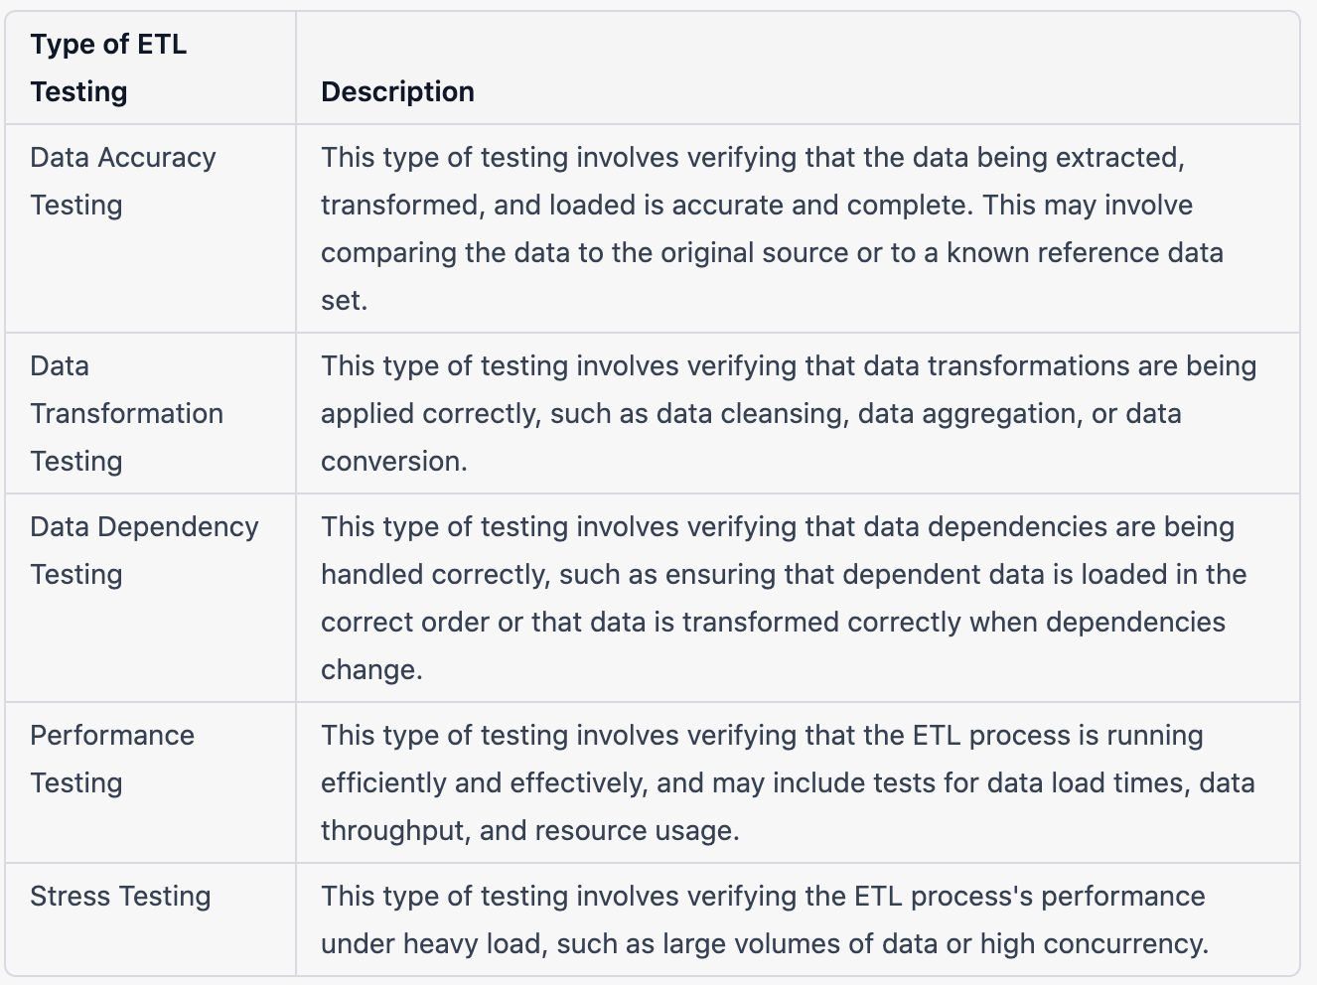
Solution Overview: Testing
Source: LinkedIn Learning and Anshul Thareja

Slide 9
Solution Overview: Testing
I believe that logging, either to a database or to the cloud, and testing are critical. We can use our knowledge of the data to set metric for notifications and reporting. We can look at logs to see if common queries are taking longer to complete than usual. We can use tools like ELK and Datadog to look at log data. We can create tests to make sure incoming data matches what we expect to see. For example, using “additive testing” where we know what is currently in the database, what is in the incoming data thus what should be present after updating. If any of these things hold, the test fails.

Slide 10
Solution Overview: HA and RBAC
By using High Availability (HA) settings in data platforms like Snowflake, which employs three regions for failover, we can create redundancy and fallback mechanisms to ensure reliability in case of failures. Frequent data backups, query response time monitoring, and specific data quality metrics enhance system robustness.
Role-Based Access Control (RBAC) ensures artists access only their data, while additional roles and tables facilitate genre-specific and comparative dashboards without exposing unauthorized data. Frequent backups also enable scenario replays and disaster recovery, with Databricks and Snowflake allowing time travel up to 90 days. Monitoring cloud applications for outages, unusual usage, and performance issues is crucial.
Source: LinkedIn Learning and Anshul Thareja

Slide 11
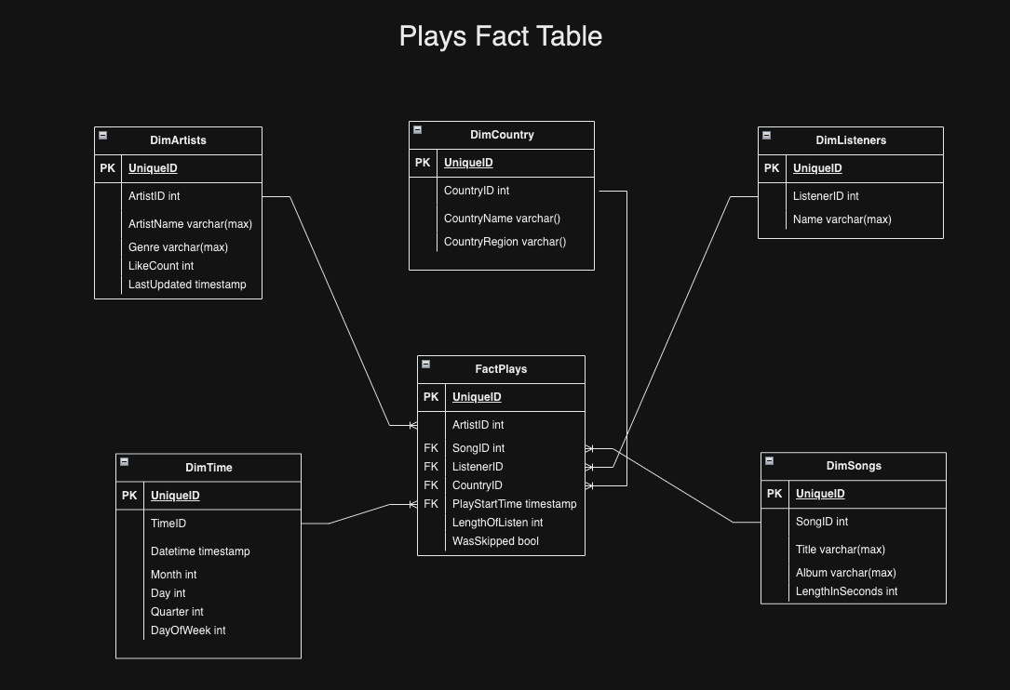
Tables

Slide 12
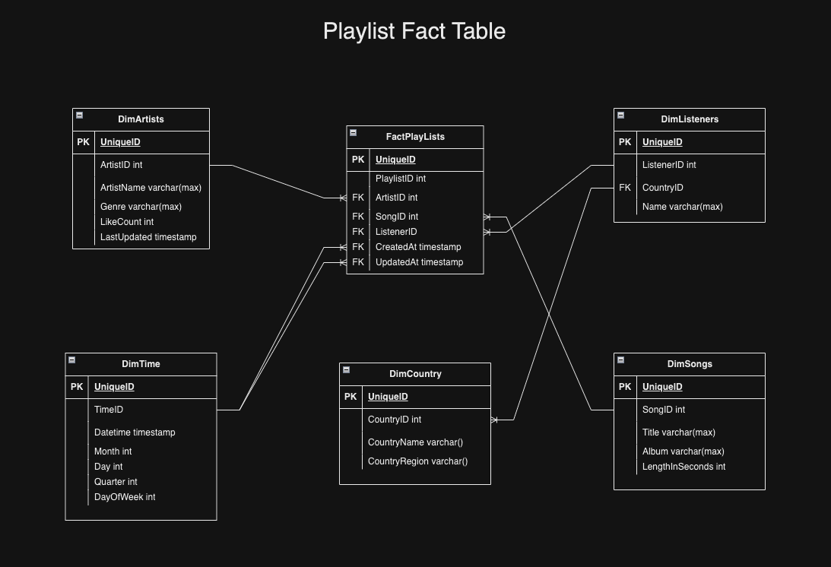
Tables

Slide 13
Part II

Slide 14

Songwriting Chatbot Overview
10 Songs (5 songs from Taylor Swift and 5 from Lana Del Rey)
Songs were parsed and stored as JSON then uploaded into a Snowflake table
A Streamlit app was created, and user questions goes through 3 steps in LangChain to write a song: 1) The name of the artist is identified. 2) Snowflake is queried for songs by artist identified in 2. 3) The songs are then embedded and a OpenAI creates a song in the same style.

Slide 15
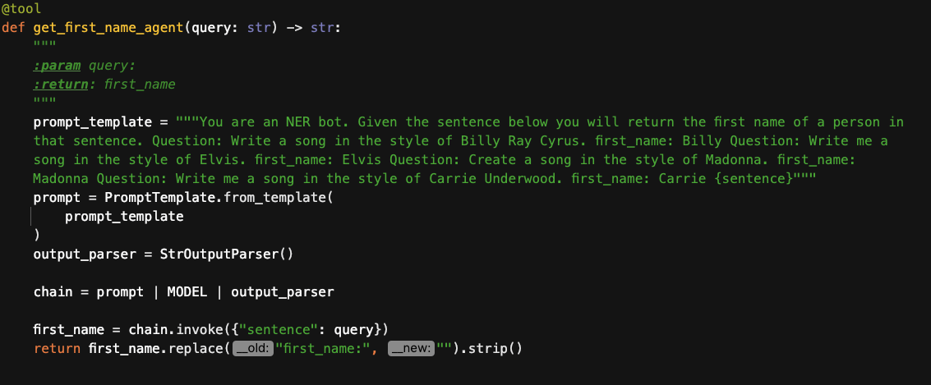
LangChain Tool to Identify Person

Slide 16
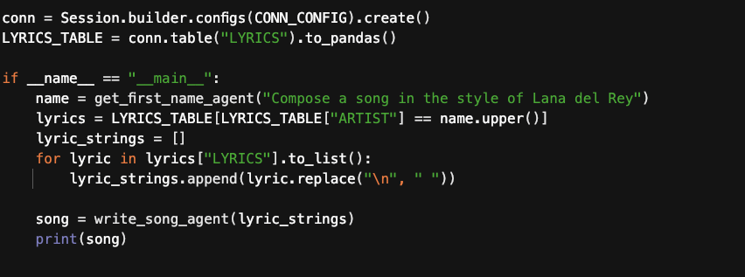
Database Query to Return Song Examples

Slide 17
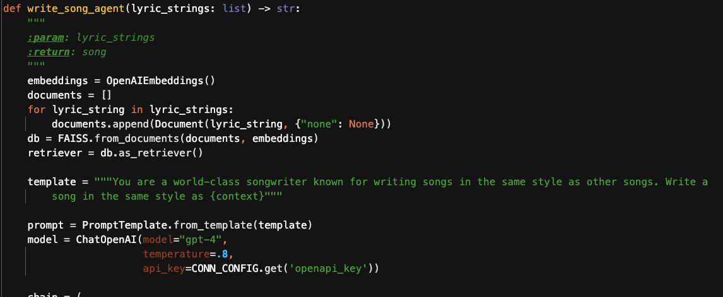
LangChain Prompt to Generate Songs

Slide 18
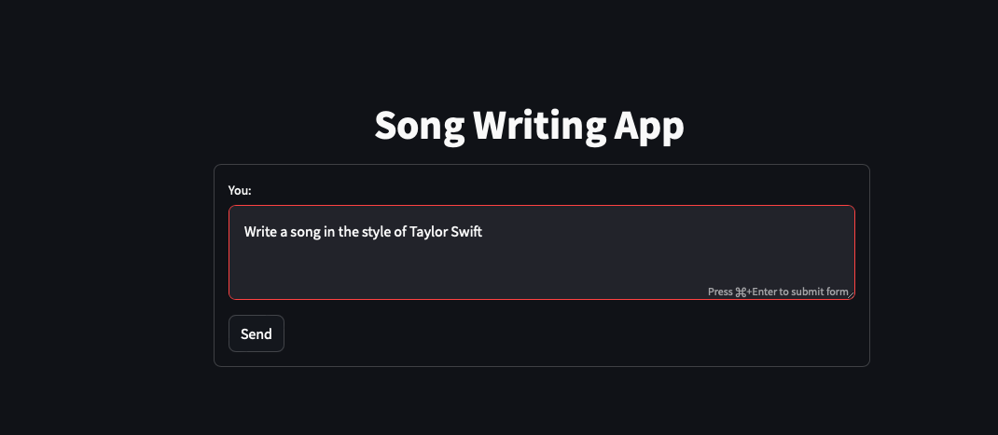
App Demo

Slide 19
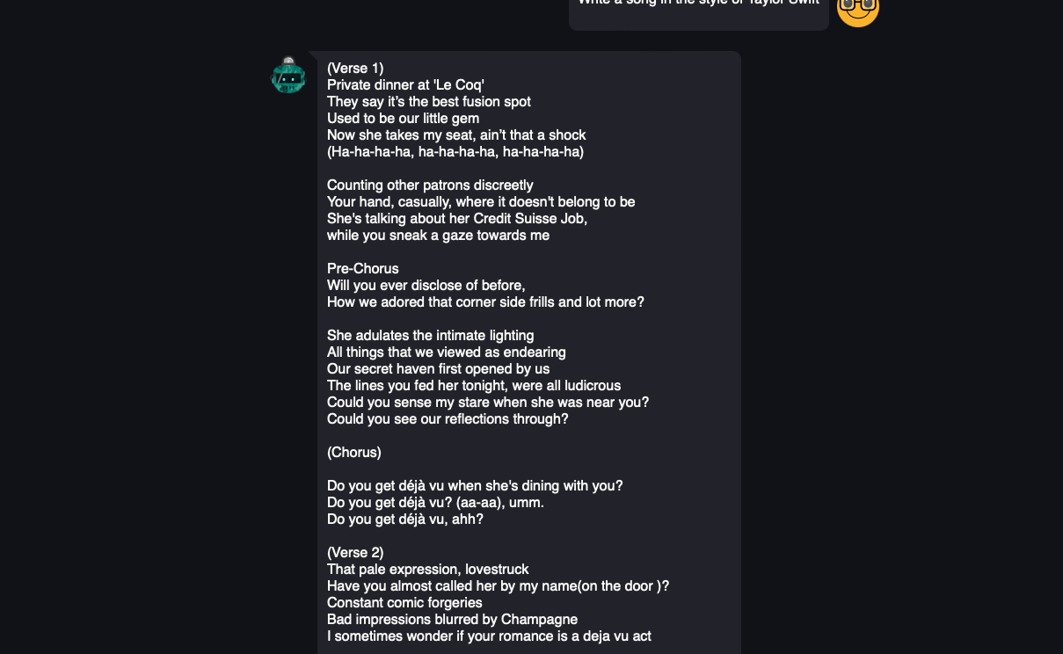
App Demo

Slide 20
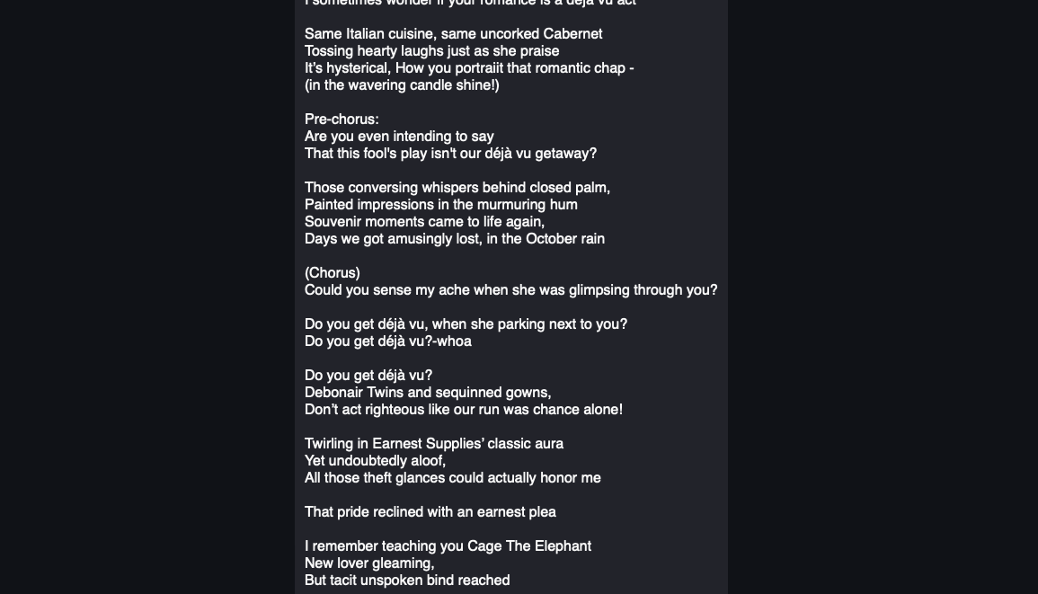
App Demo

Slide 21
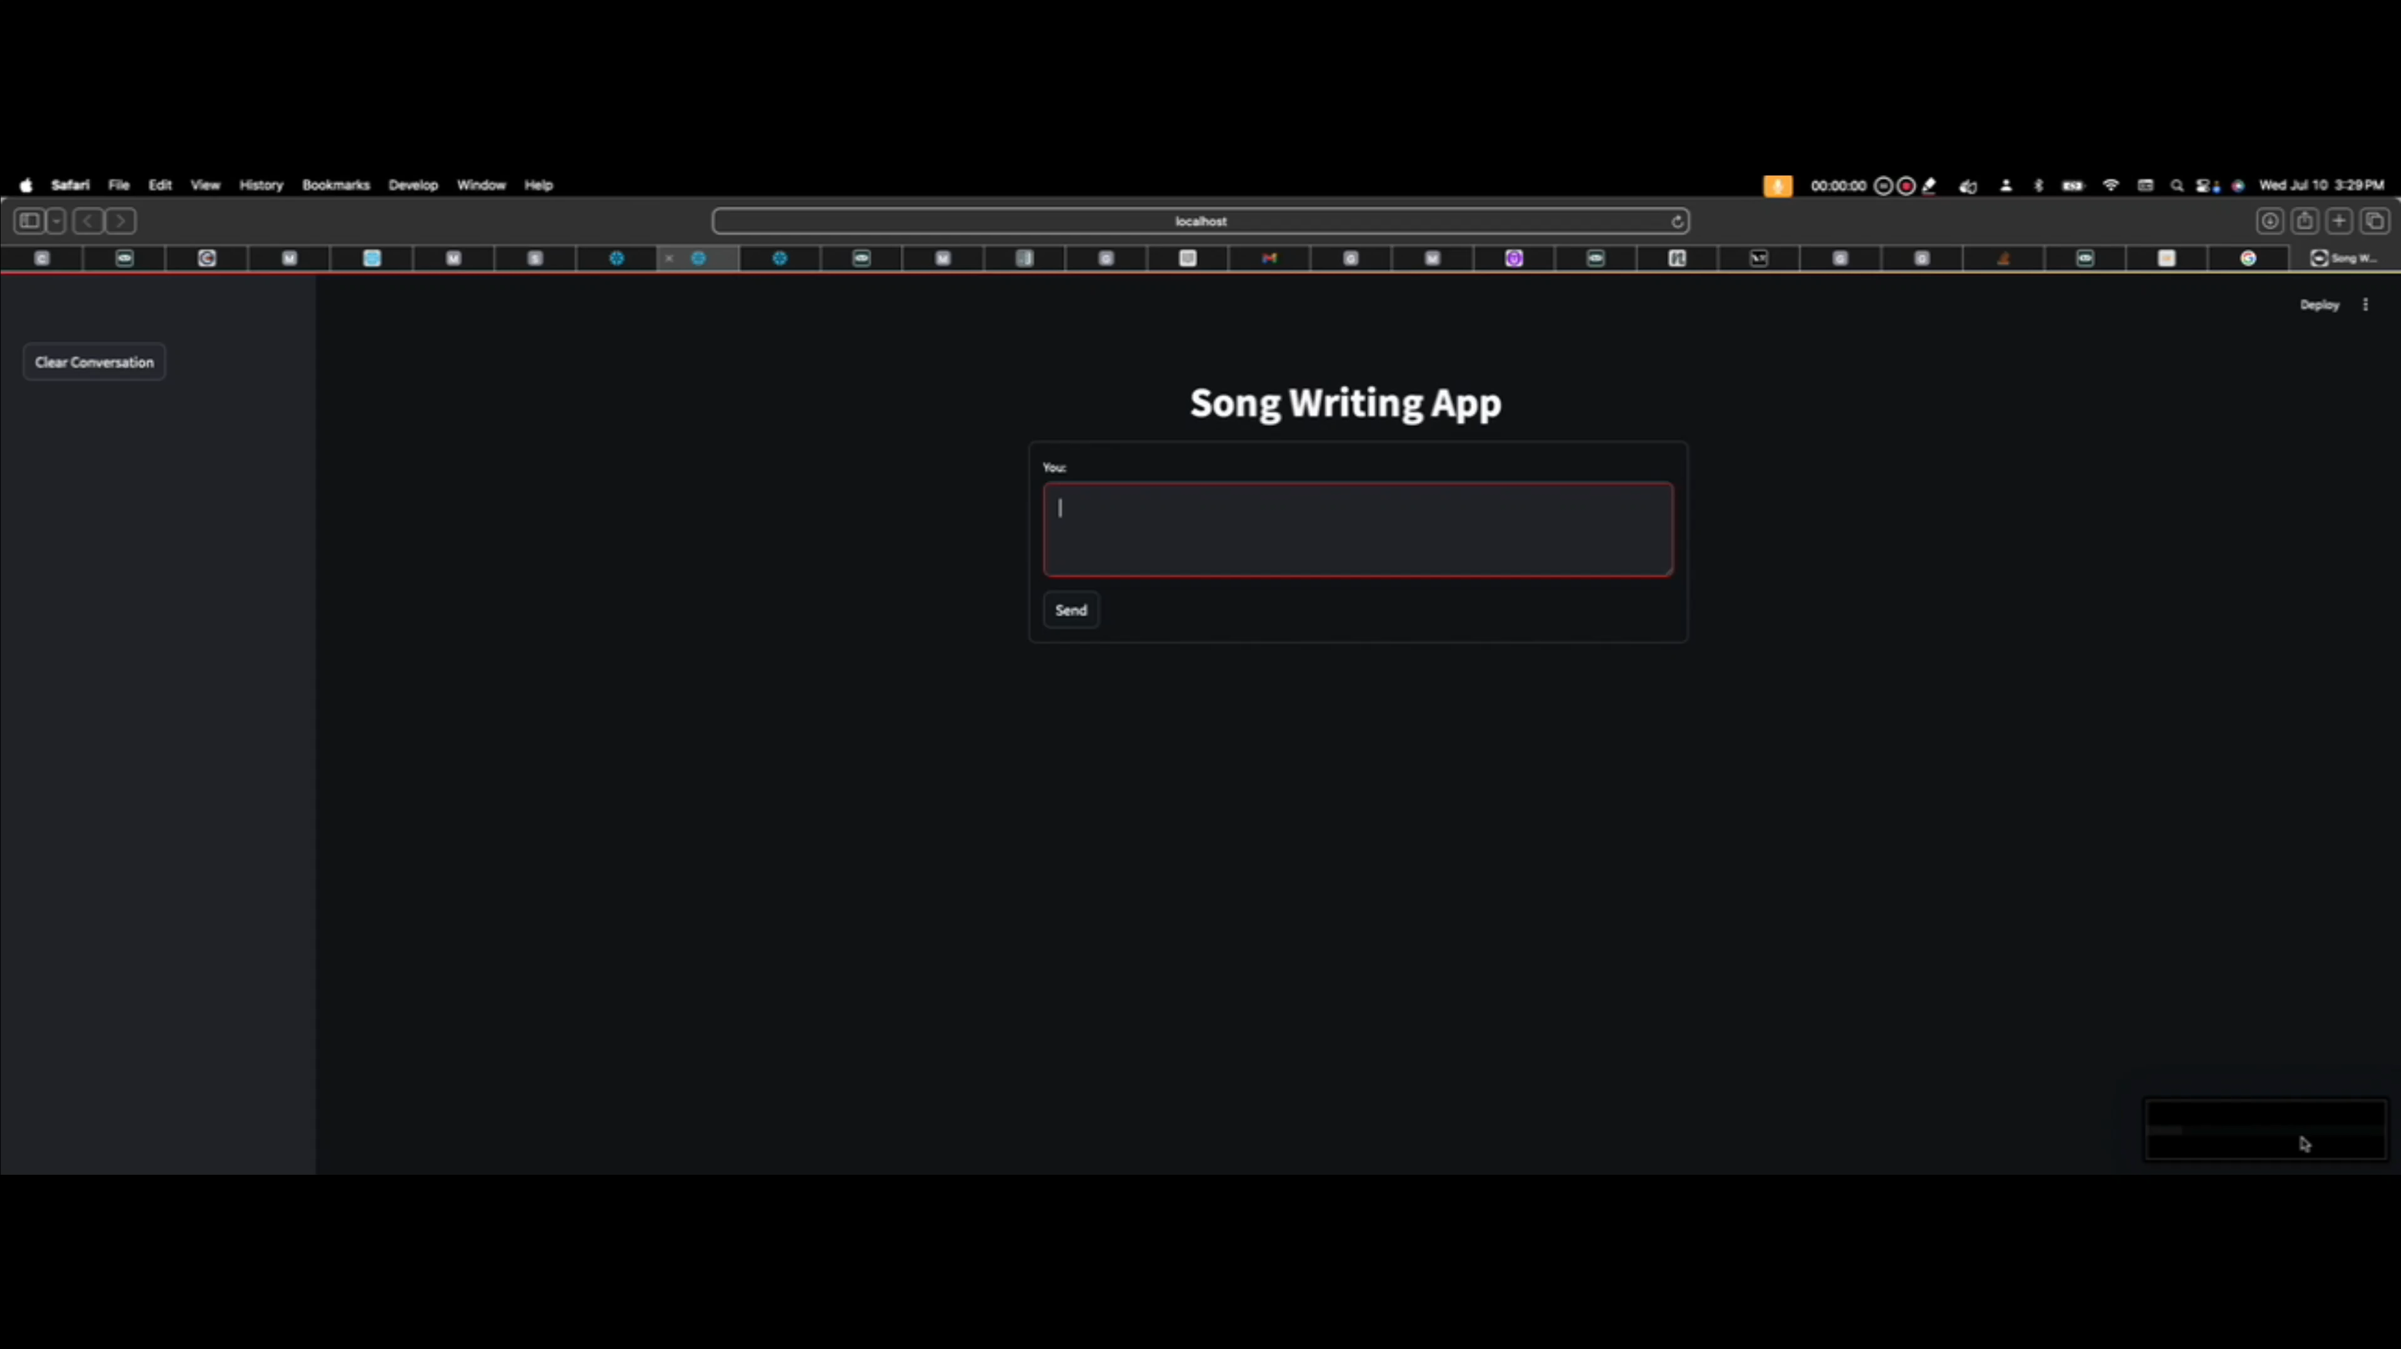

Slide 22

Overview
About the data. From UC Irving: “These data are the results of a chemical analysis of wines grown in the same region in Italy but derived from three different cultivars. The analysis determined the quantities of 13 constituents found in each of the three types of wines. ”
The dataset consists of one set for red and white data and is good for classification.
Included in my Github repo is the code that shows the combining of the two datasets, table creation in Snowflake and uploading combined data into Snowflake.
Exploratory analysis and feature selection is then performed.
The chosen features are then modeled and pushed to registry in Snowflake and an inference service serves this model in a Docker container.

Slide 23
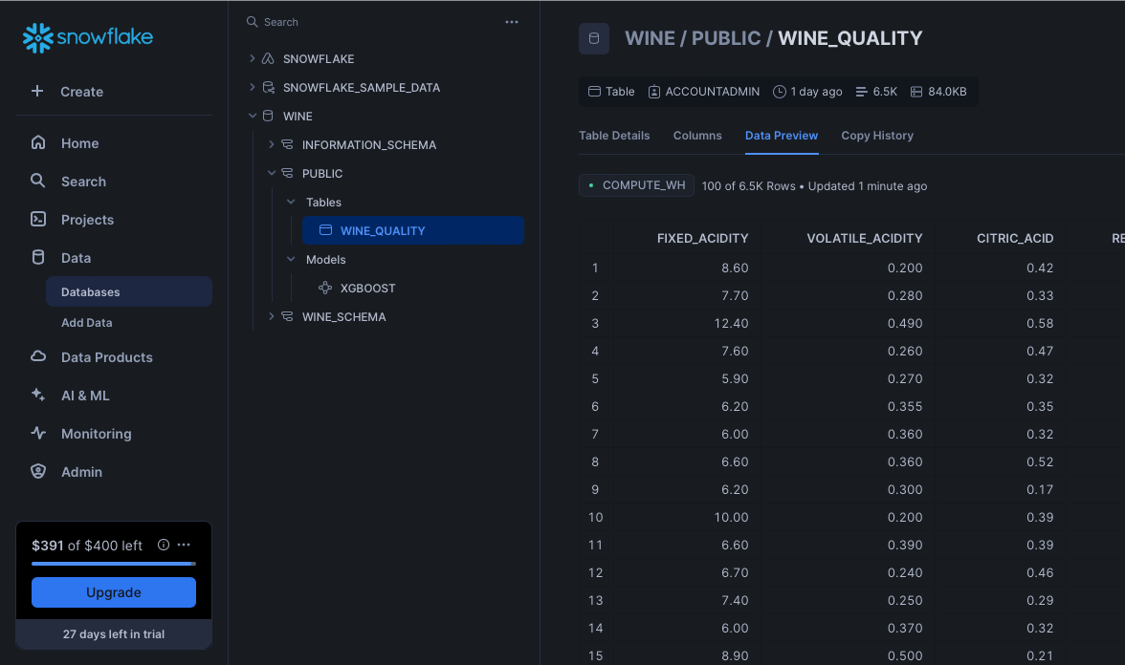
Data Engineering

Slide 24
Exploratory Analysis

Slide 25
Feature Selection

Slide 26
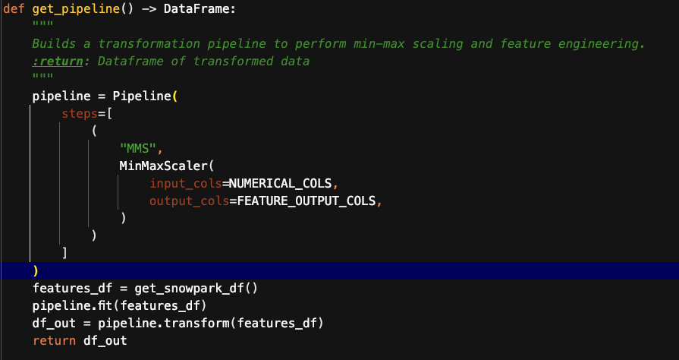
Feat. Eng. Pipeline

Slide 27
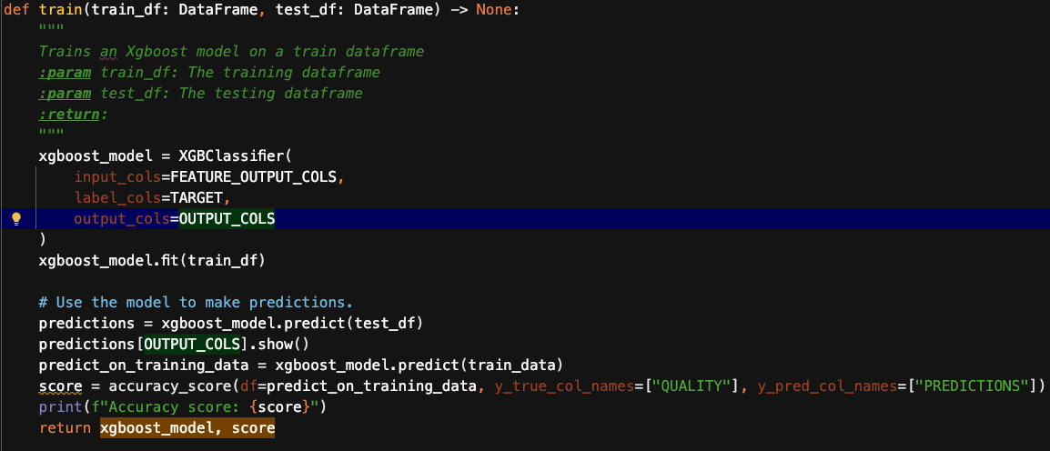
Model Pipeline

Slide 28
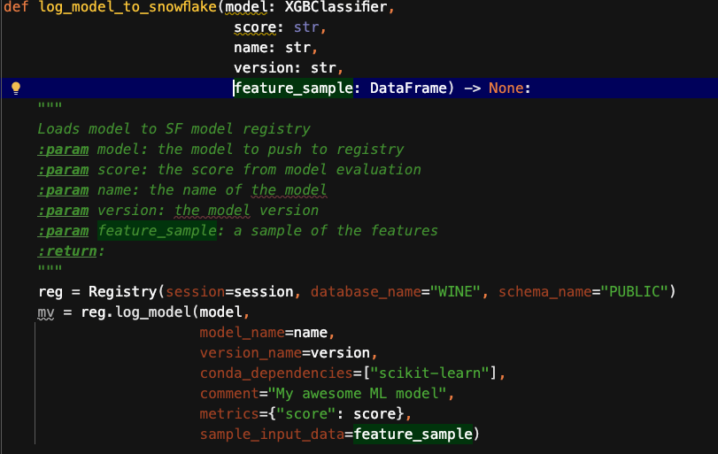
Model Repo

Slide 29
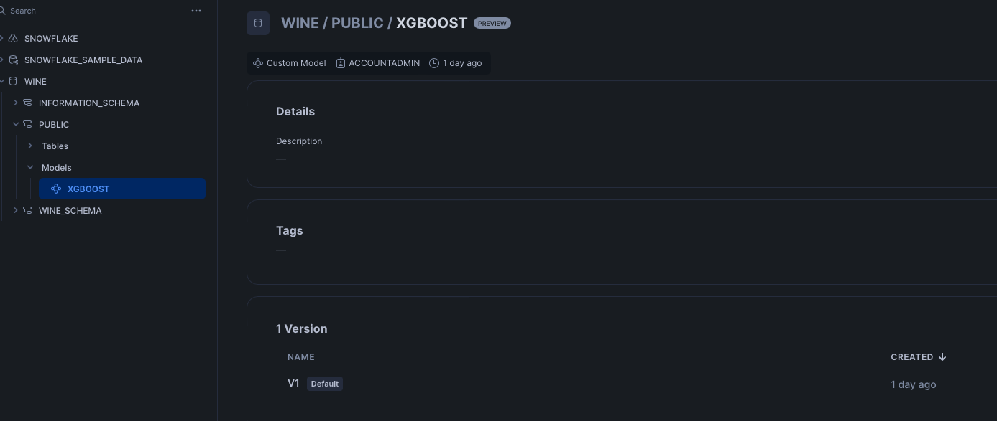
Model Repo

Slide 30
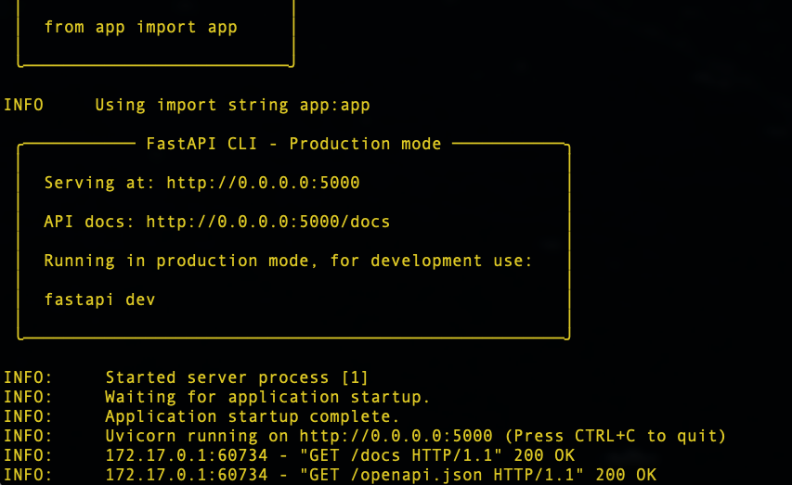
Inference Service

Slide 31
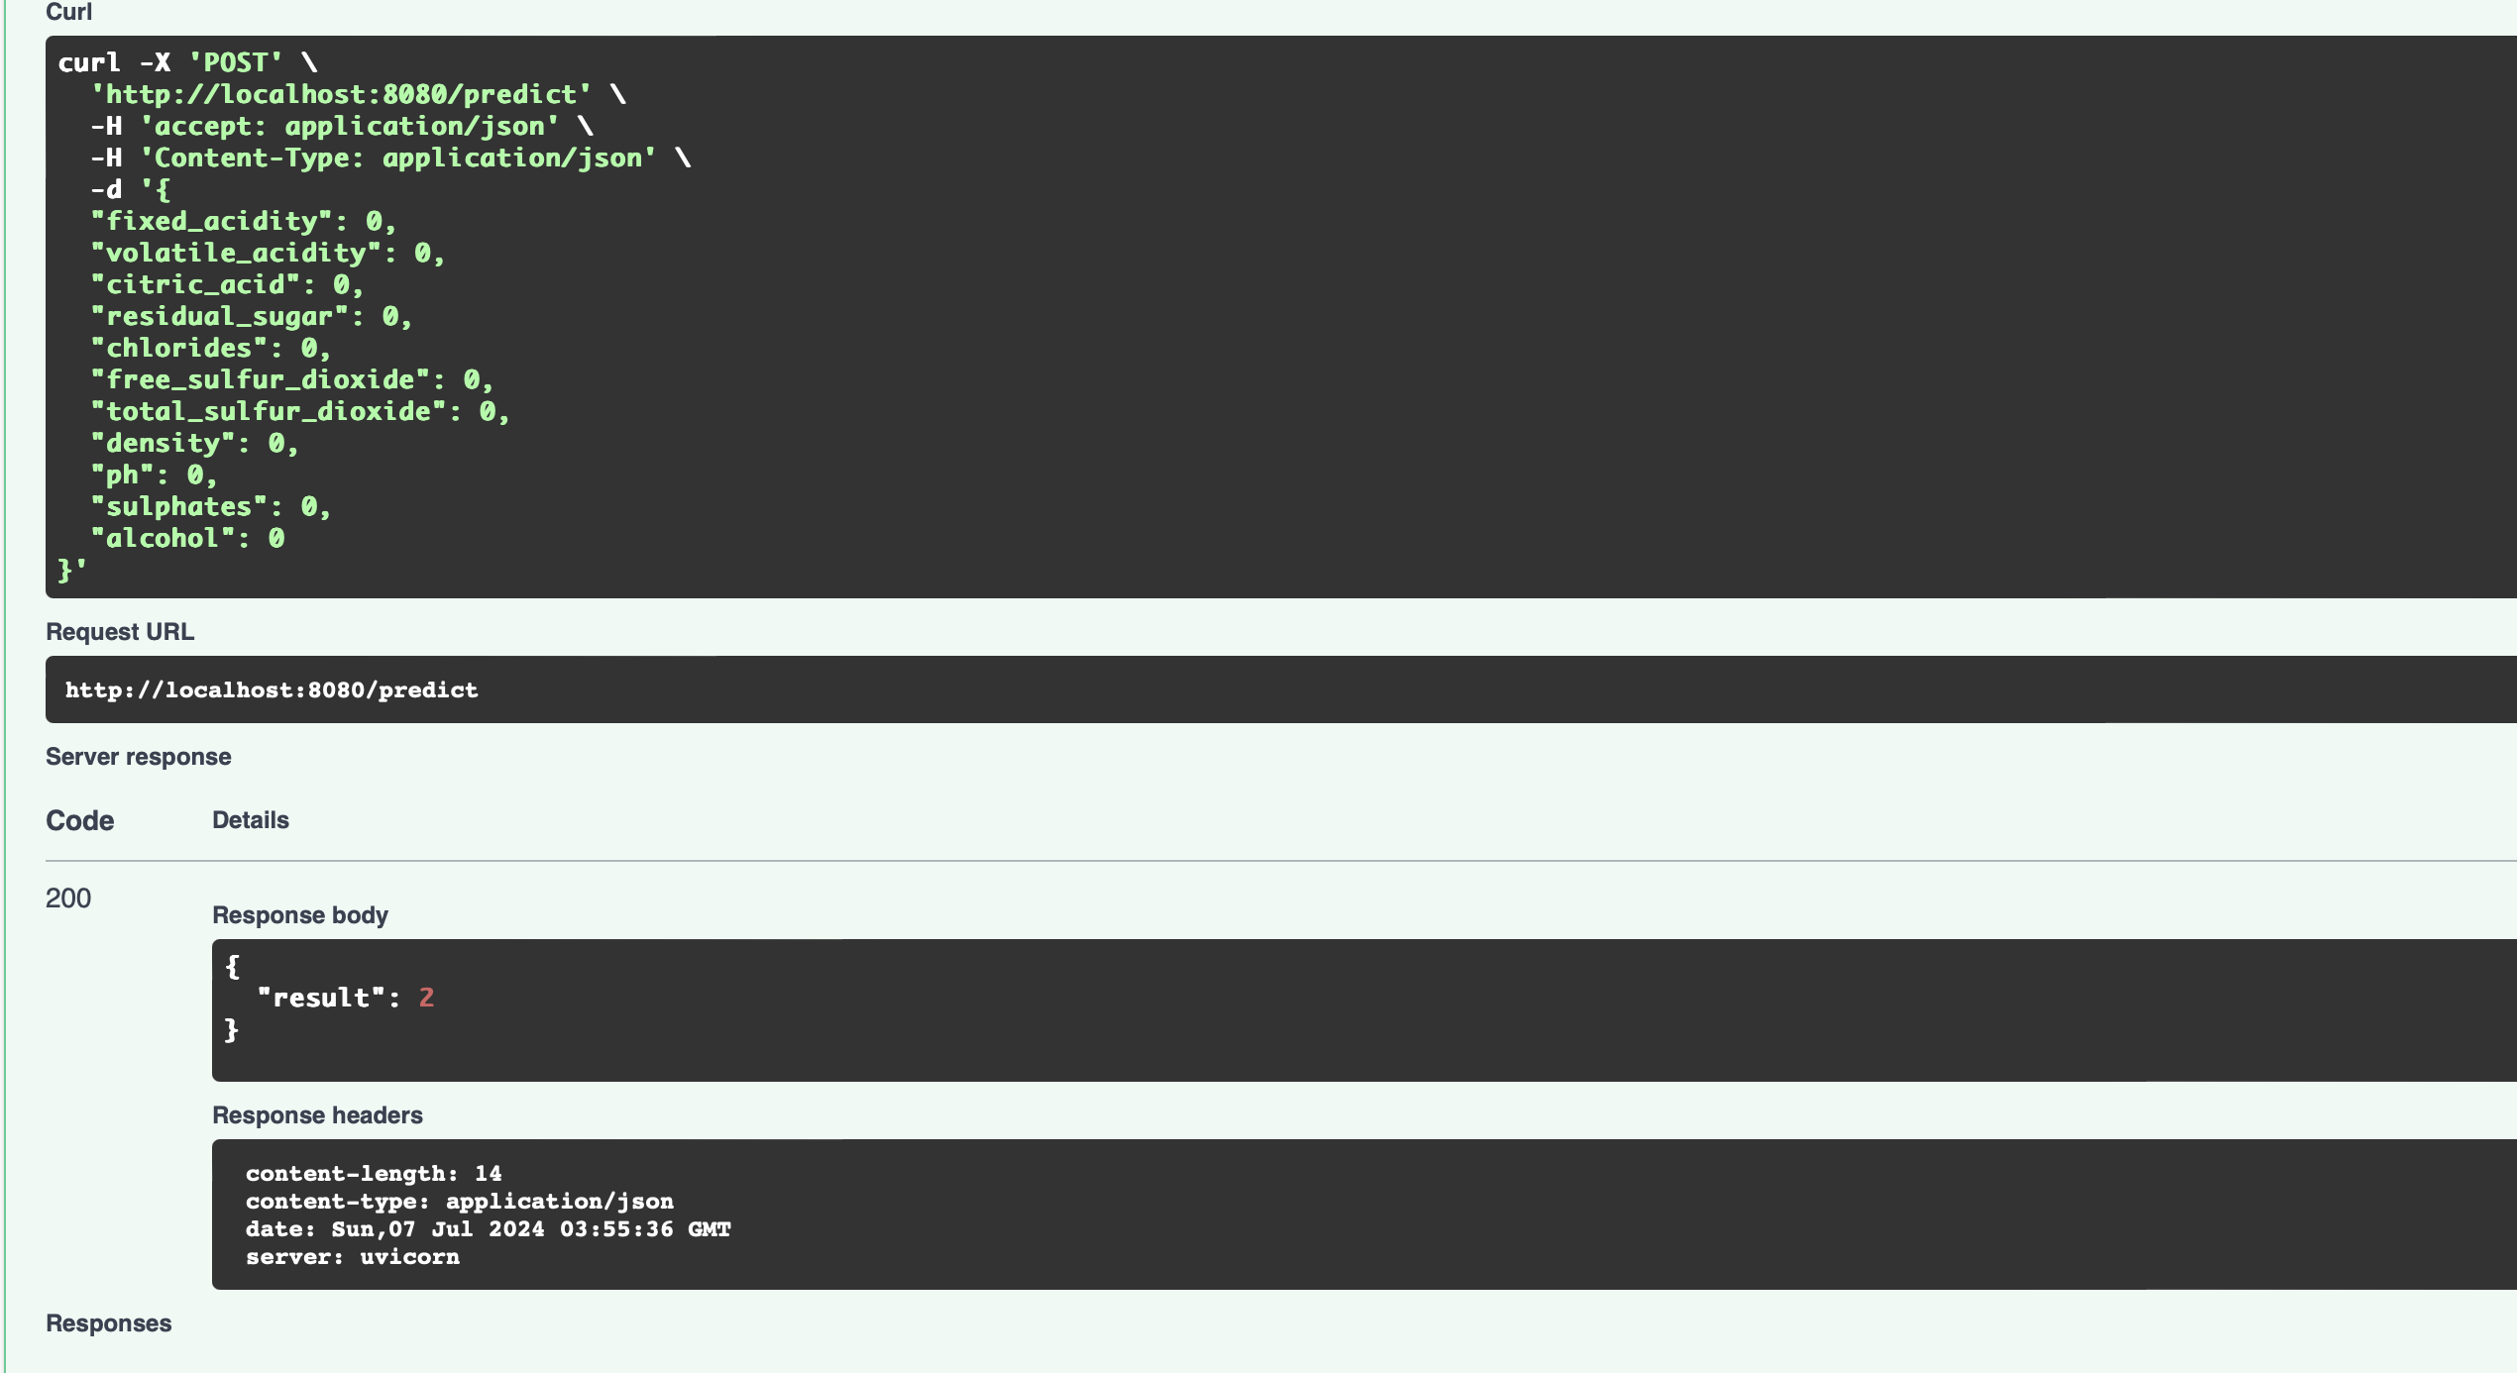
Inference Service

Slide 32
Additional Information

Slide 33
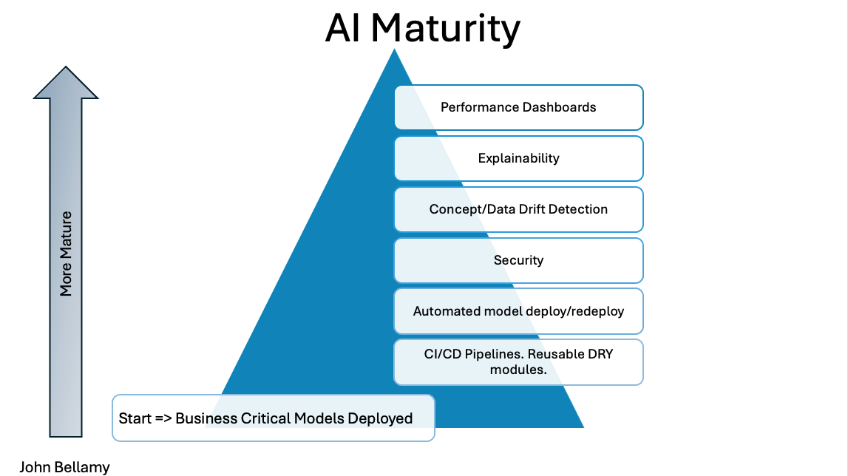
AI MATURITY

Slide 34
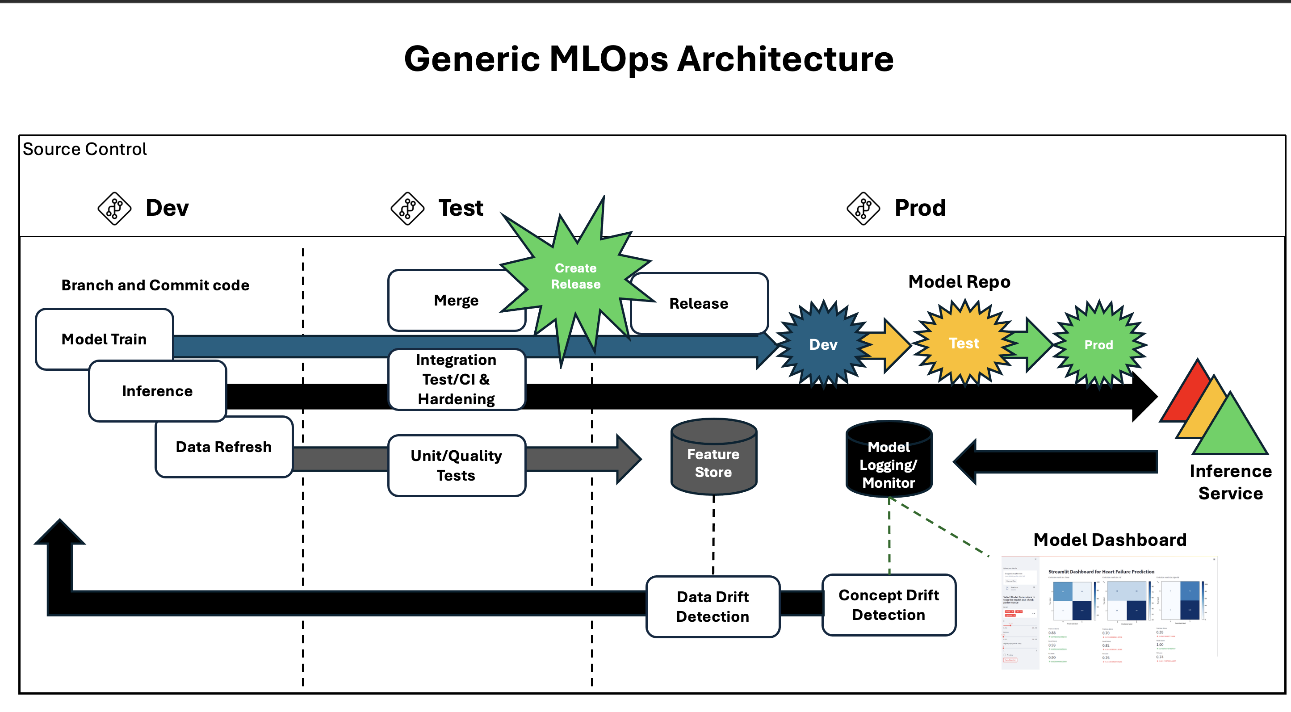
MLOps Arch

